Slide 1
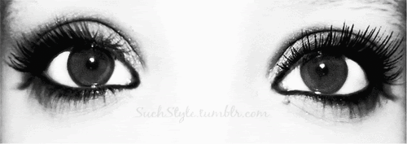
Eyes
Colin Mayer
Jane E

Slide 2
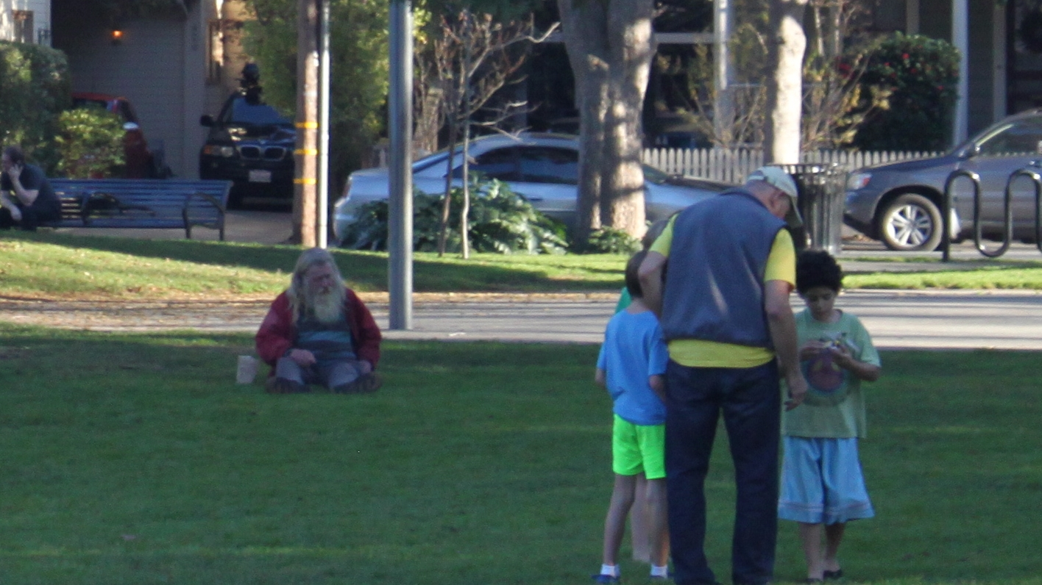

Slide 3

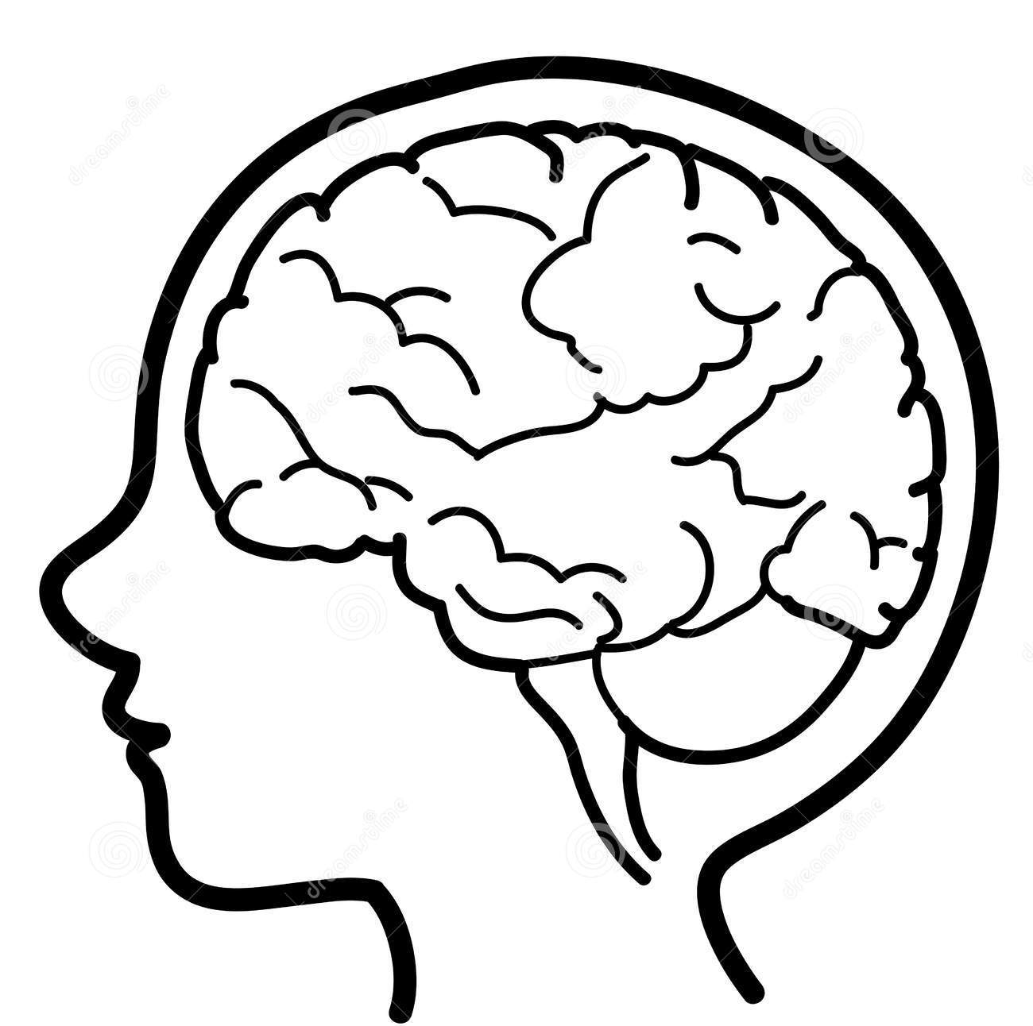
What emotions did that trigger?
How did the change in images influence your perspective?
Context
Notice how context dictated
your response to the content.

Slide 4
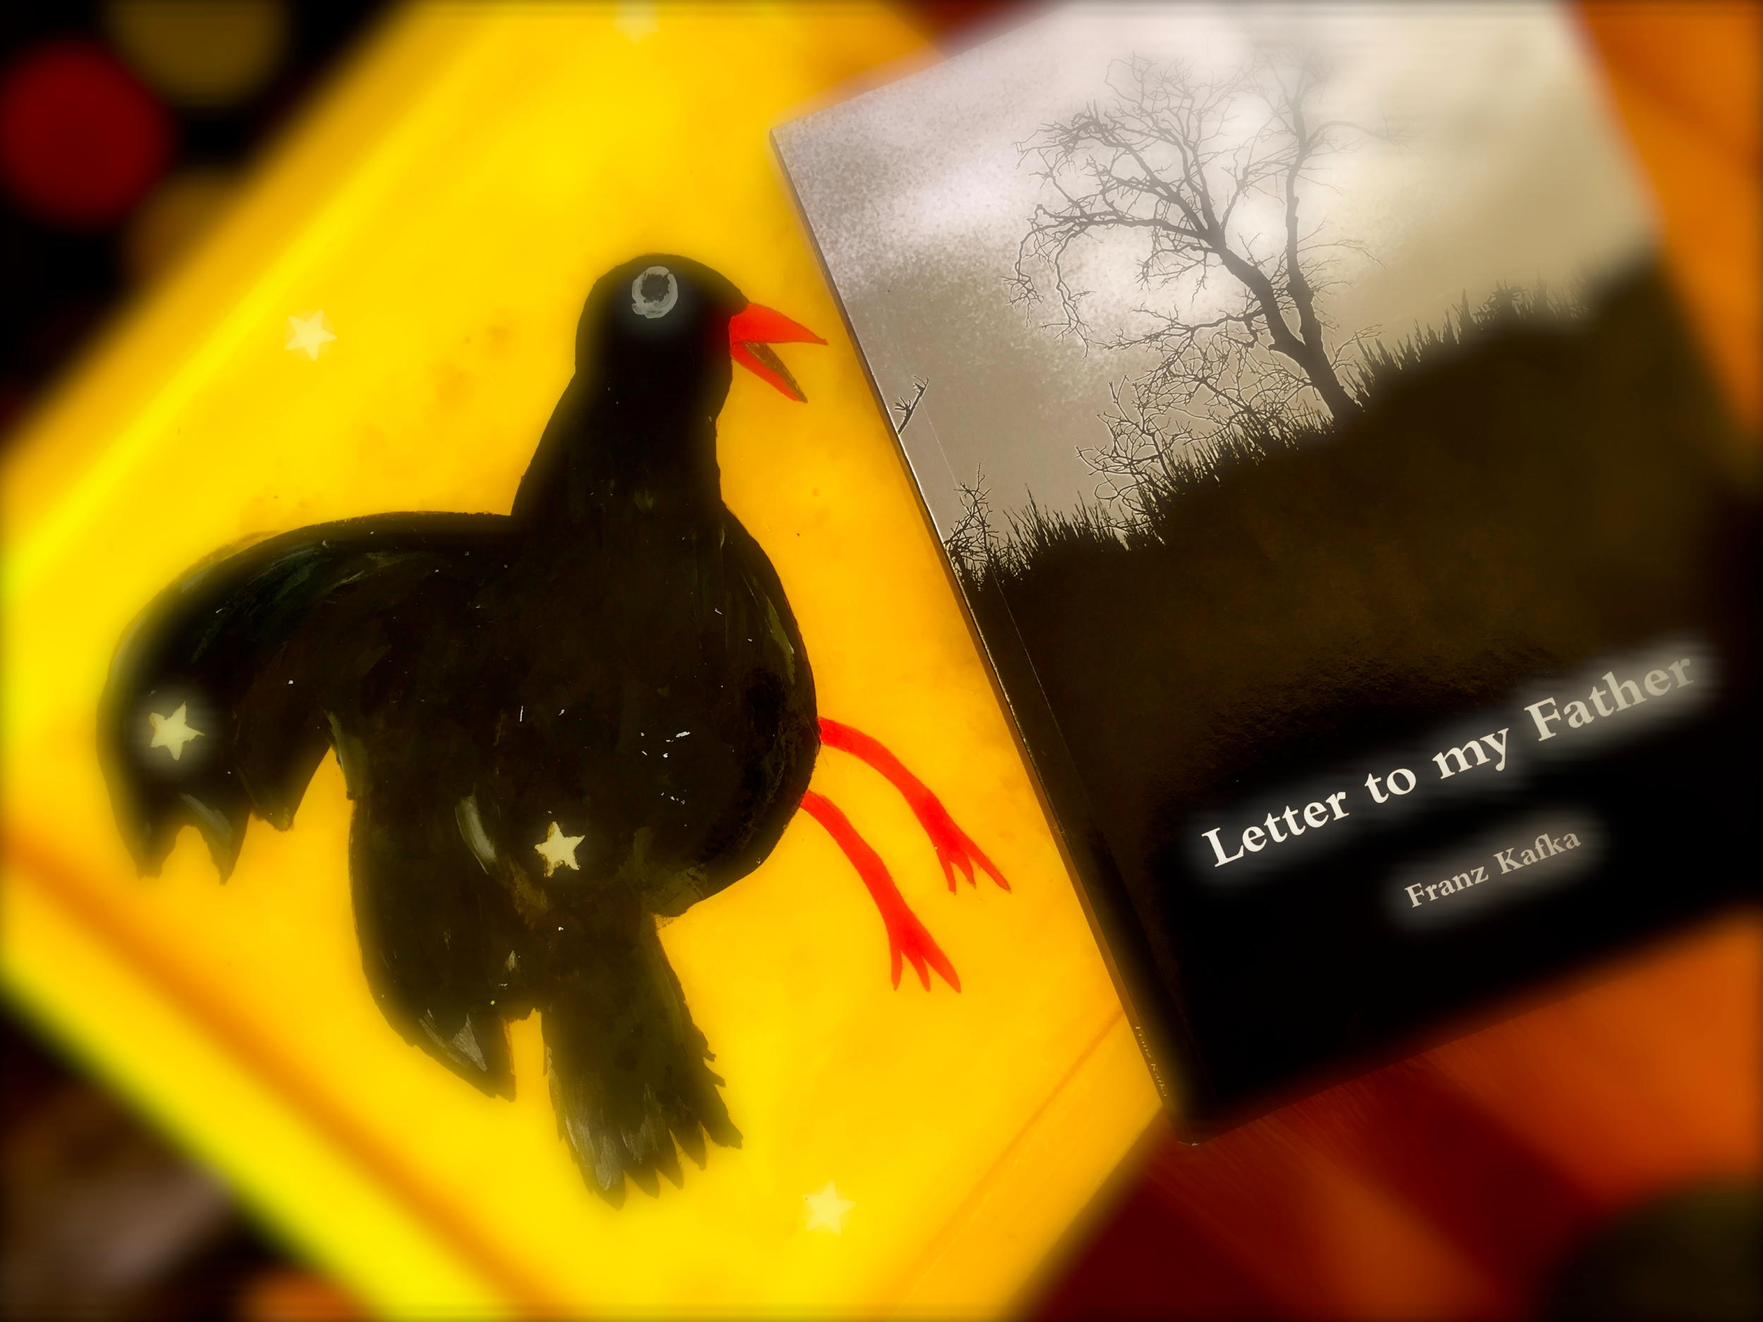
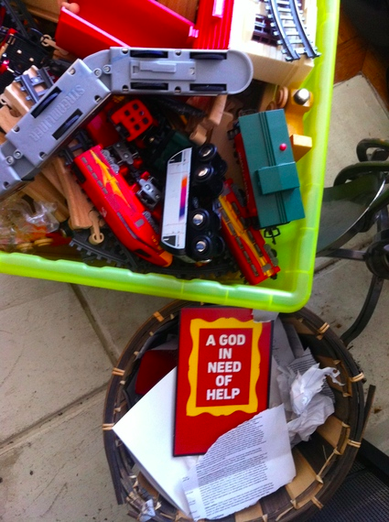

Exhibit A
Author and speaker
Uses imagery as contextual complement
Interesting perspective on capturing images to influence audience

Slide 5
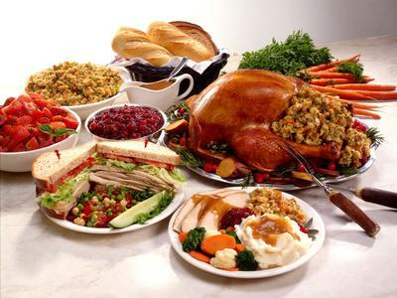
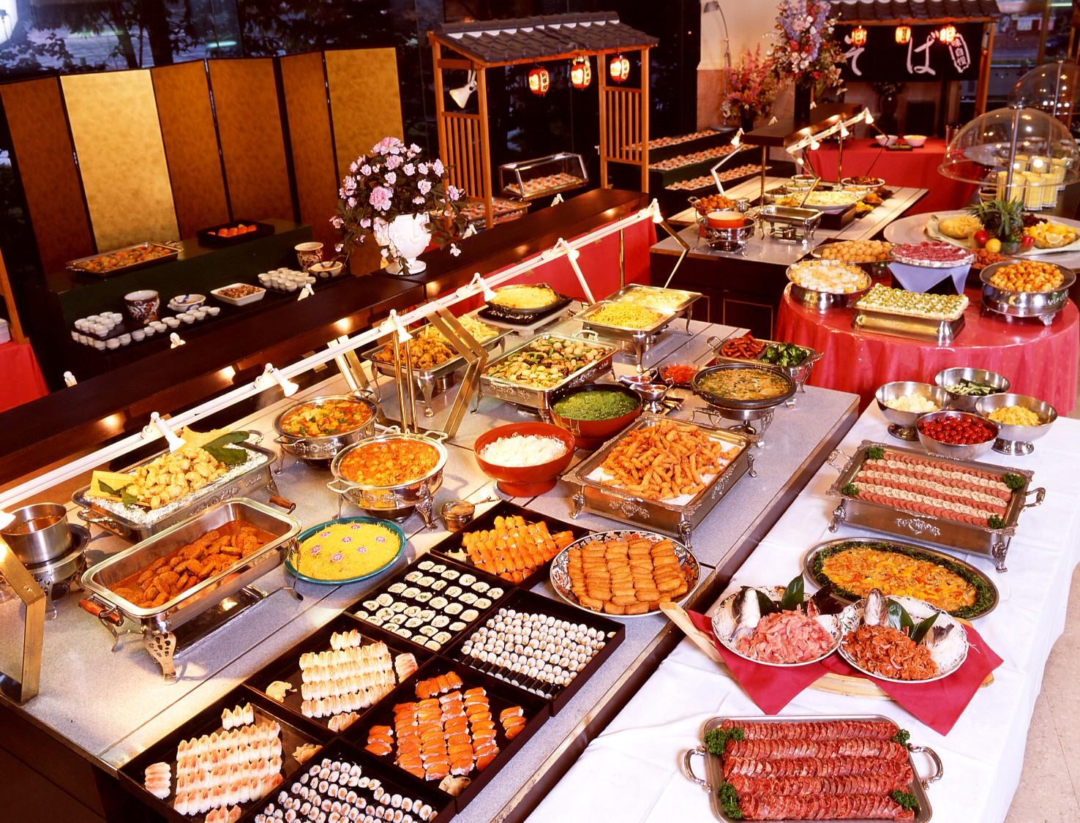
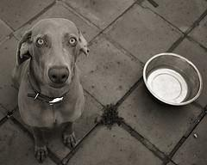

Content
Context
hunger

Slide 6
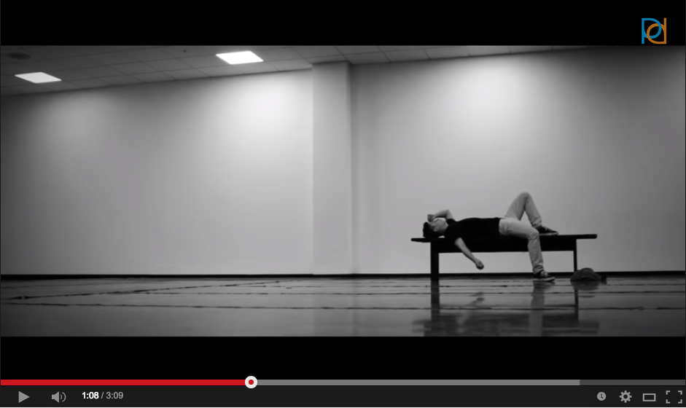
Exhibit B
Videographer, Dancer
Became interested in filmography and the “magic” behind Hollywood early on
Produces a variety of videos mostly for the dance community, but also some just to experiment with effects

Slide 7
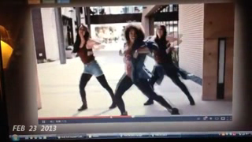

Slide 8
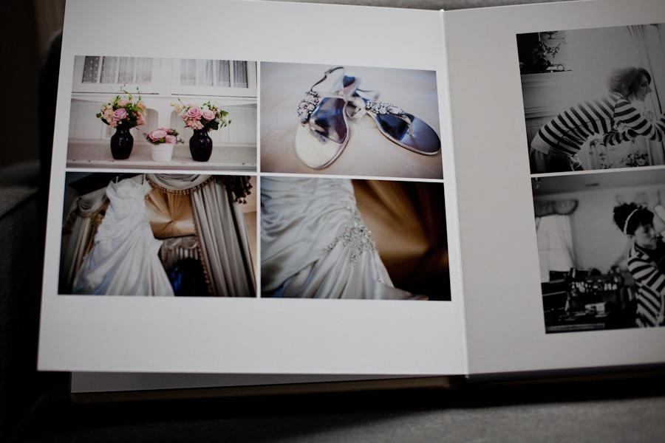


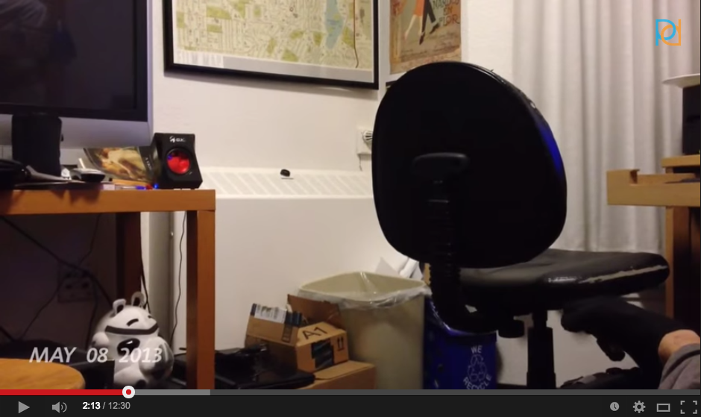
Content
Context
images from a year of life
Notes:
realism vs effects, personal secret code

Slide 9
Background and Needs
Means to capture
visual
auditory
time/moment
Means to experience
albums
slideshows
videos

Slide 10
Solution
Something like Google Glass?
Capture random moments based on analyzing activity in frame
Natural, untainted

Slide 11
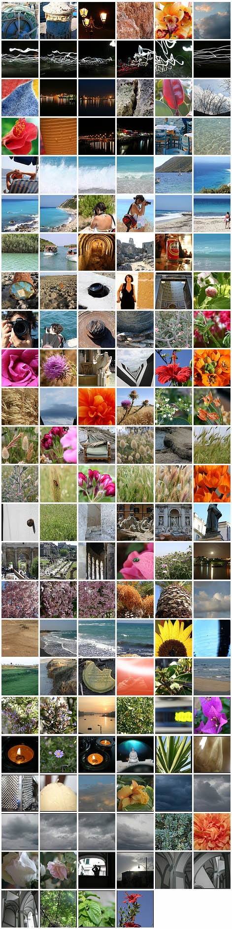

1 second a day creates context for the past
What about context for the future?
The future is unknown,
context is built from experiences
2013 2014 2015 2016

Slide 12

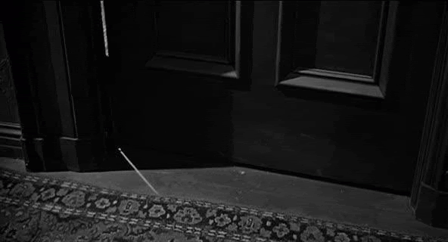


Slide 13
How did the images effect your expectations for the opening door?
We can see how our experiences influence our perspective on the future.

Slide 14

unkown, unseen, unexperienced
Context
Notes:
The same loop
When the content becomes the unknown, the context is your experiences and perspective

Slide 15
Exhibit A (revisited)
Culture Broker
Research on uncertainty avoidance
Americans are much more likely to embrace uncertainty

Slide 16
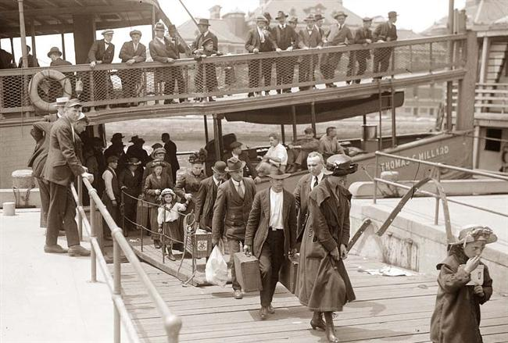

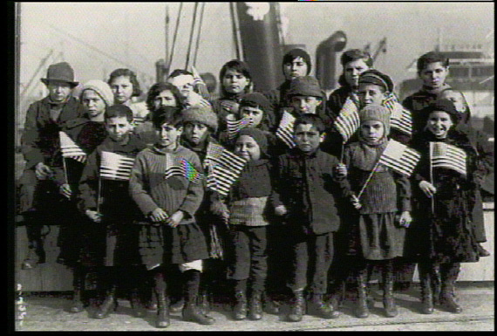


Notes:
History of embracing uncertain future, Americans more likely to borrow money for education/houses

Slide 17
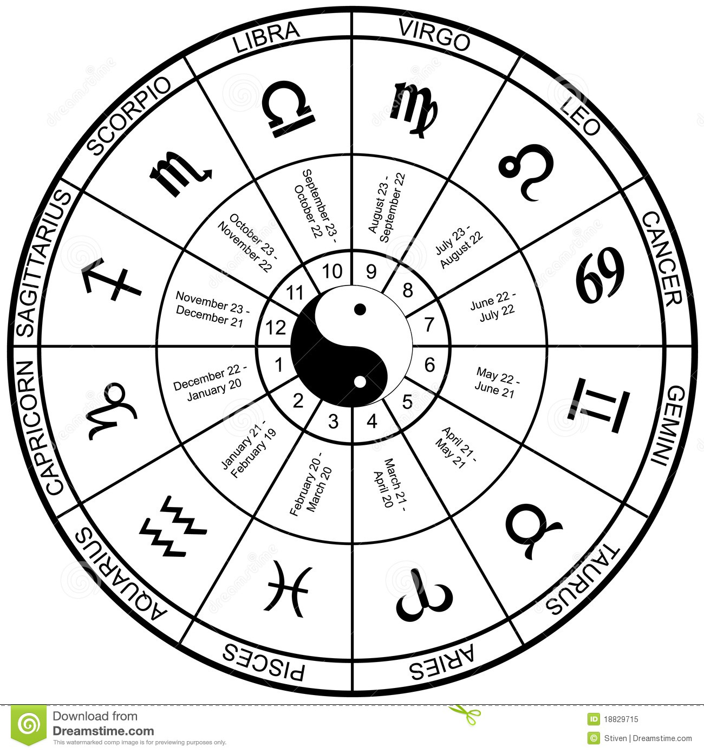

Exhibit C: Allison
UX Designer
Yoga Enthusiast
Daily Horoscope reader

Slide 18
1 Unread Message:
Your new contract is on my desk,
please come by as soon as possible to sign...
Gemini: With Saturn on the dark side of the
moon it is poor time to make permanent
business decisions
Gemini: As Orion comes into alignment with
Jupiter your luck will favor new agreements

Slide 19
Embracing Uncertainty
People will always want a better approach to the unkown
The power of a positive mental attitude
If we can influence people’s experiences we can influence how they will approach the unknown
This is why people read horoscopes
Need a horoscope for scientists

Slide 20
Solution
Smartphone alarm clock with an influential quote, cartoon or short film
Provides a new perspective each morning
Uplifting
Reassuring
Realistic (not all days are good ones)

